Slide 1

Color Imaging

Slide 2
Describing Chromatic lights
Radiance (watt):
  Total amount of energy flow from the light source.
Luminance (lumens, lm):
  measure of amount of energy an observer perceives from a light source. It varies based on distance from the source, wavelength, etc.
Brightness:
  a subjective descriptor, describing color sensation.

Slide 3
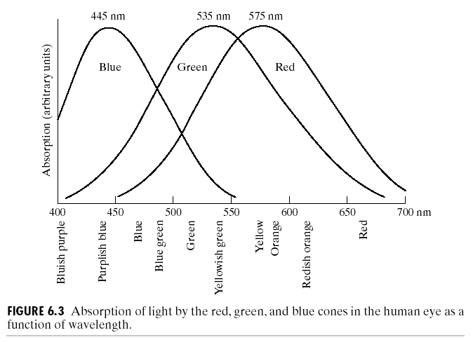
Primary Colors
Primary colors of light (additive):
  Red (700 nm), 65% cones sensitive to red light.
  Green (546.1nm), 33%
  Blue(435.8nm). 2% cones sensitive to blue light.
Mixing of R,G,B may NOT generate ALL visible colors.

Slide 4
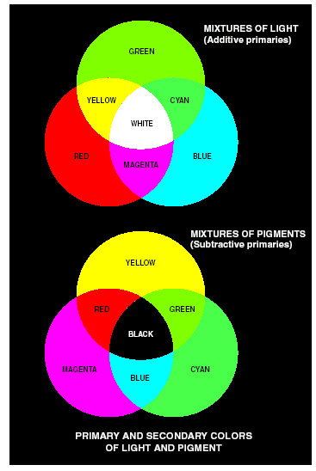
Primary and Secondary Colors of Lights and Pigments
Primary colors of pigment (subtractive):
  magenta,
  cyan, and
  yellow.

Slide 5
Characterization of Color
Colors are distinguished from one another based on brightness, hue, and saturation.
Hue:
  an attribute associated with the dominant wavelength in a mixture of light waves. It represents the dominant color as perceived by an observer.
Saturation:
  specifies relative purity or the amount of white lights mixed with a hue.
Hue and saturation together are called chromaticity.
Example: color palette

Slide 6
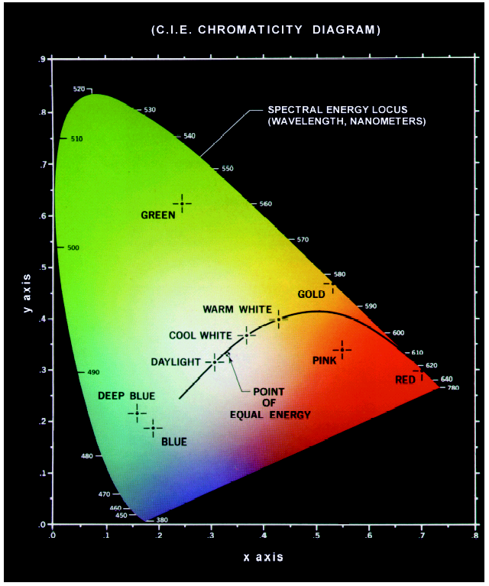
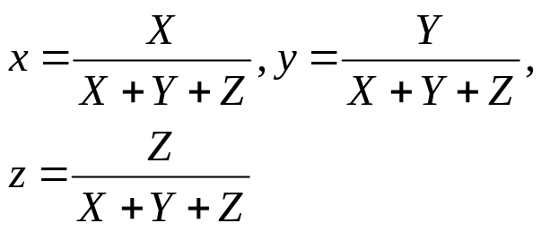
Chromaticity Diagram
Tri-chromatic coefficients:
  Let X, Y, Z: tri-stimulus values representing the amounts of red, green, and blue needed to form any particular color.
  Since x + y + z = 1, x and y along will make a chromaticity diagram
CIE Chromaticity diagram
  x-axis: red, y-axis: green
  Color on boundary are completely saturated.
  Saturation @ pts of equal energy is zero

Slide 7
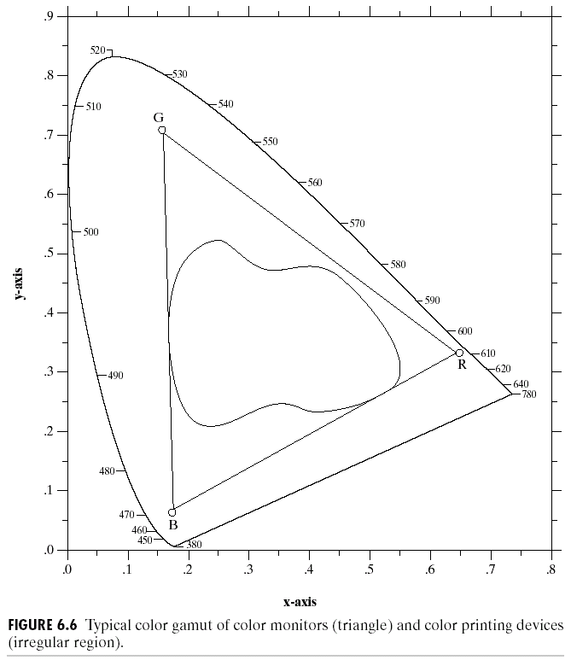
Color Gamut
Any 3 points in the chromaticity diagram can produce all colors within that triangle. Due to the tongue-shape indicates that no mixing of three primary color can produce ALL possible colors

Slide 8
Color Models
RGB color model: monitor, video
CMY (CMYK) color model: printing
HIS: close to HVS

Slide 9
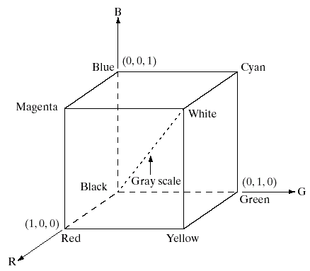
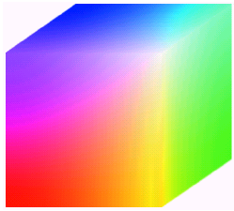
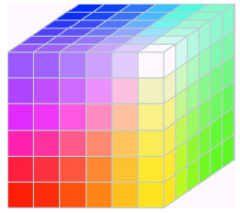
RGB Color Model
R, G, B at 3 axis ranging in [0 1] each
Gray scale along the diagonal
If each component is quantized into 256 levels [0:255], the total number of different colors that can be produced is (2⁸)³ = 2²⁴ = 16,777,216 colors.
RGB safe color:
  Quantize each components into 6 levels from 0 to 255.
24-bit RGB color cube
RGB safe color cube

Slide 10
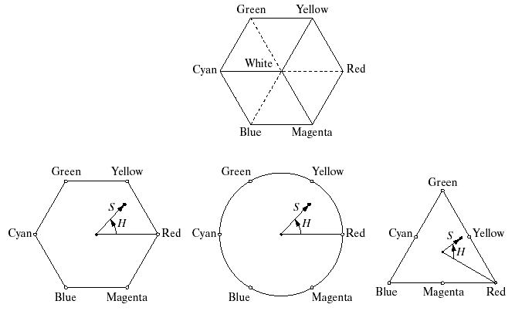
HSI Color Model
Hue:
  an attribute describing pure color
Saturation:
  The degree of which a pure color is diluted by white light.
HSI model
  Hue and saturation lie in a plane perpendicular to an intensity axis.

Slide 11
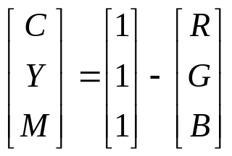
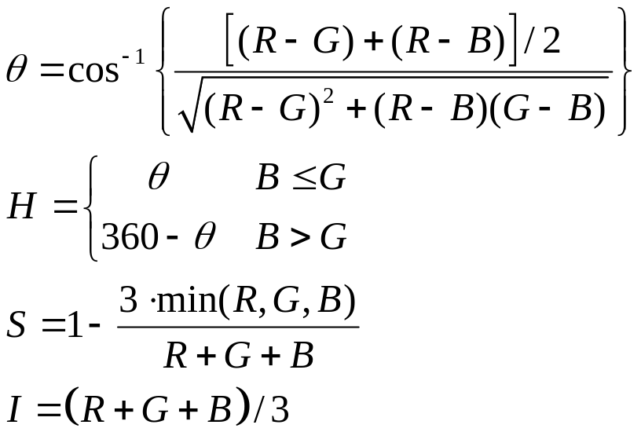
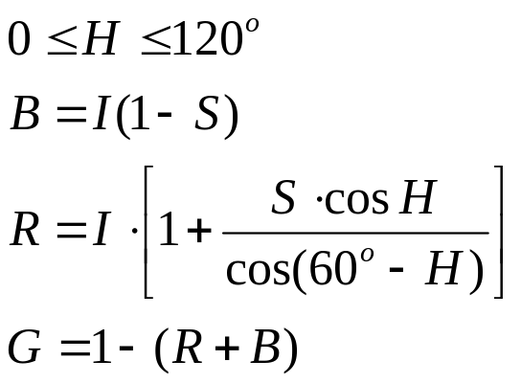
Color Coordinate Transform
RGB → CYM
HSI → RGB
  Others see text book
RGB → HSI

